Slide 1

WELCOME TO FOUNDATION 2

Slide 2
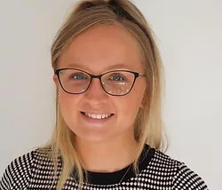
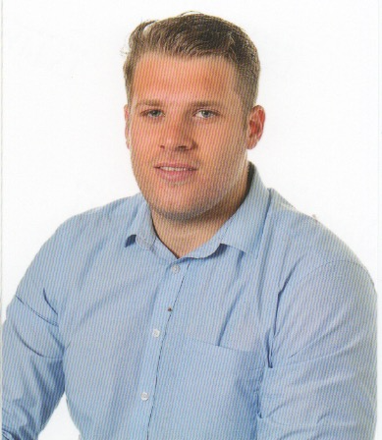
CLASS TEACHERS
Miss O’Hare
If you want to talk to your child’s teacher, we are both available each morning and afternoon on the playground.
You should now know who your child’s class teacher is. If not, please speak to one of us at the end.
Mr Miller

Slide 3
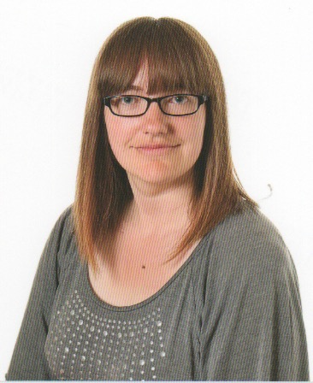
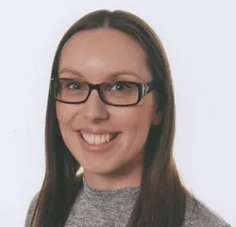
TEACHING ASSISTANTS
Miss Bill
Both of our teaching assistants are extremely knowledgeable and if your child’s class teacher is unavailable, they will also be happy to talk to you.
Miss Bill works primarily with Mr Miller’ class and Mrs Drury works with Miss O’Hare’s class. Mrs Drury (HLTA) will also cover classes when the teachers are on PPA and Management time.
Mrs Drury

Slide 4
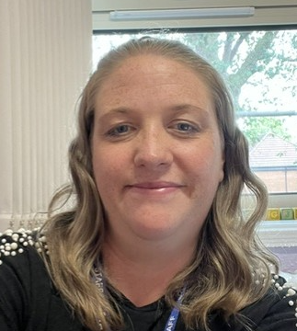
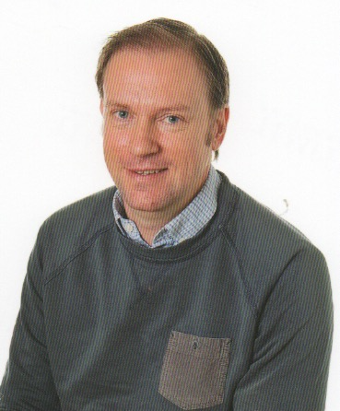
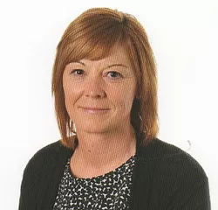
SUPPORT STAFF
Mr Dodson and Mrs Thompson are our SENDCOs/Inclusion Leads and support children and families across the whole school. If you have any concerns or would like any advice or support, they are always happy to help.
Mrs Morton supports children if they need help developing their speech and language skills. She also covers some classes when Miss O’Hare or Mr Miller are out for PPA or Management time.

Slide 5
THE SCHOOL DAY
08:40 – Gates open for children and parents to enter the playground.
08:40 – F2 doors open for the start of school.
09:00 – Phonics
09:30 – Learning through play
11:15 – Whole class teaching
11:45 – Lunch time
12:45 – Afternoon register
12:50 – Maths
13:15 – Learning through play
14:30 – Whole class teaching
15:00 – Story time
15:15 – Home time

Slide 6

SCHOOL DINNERS
All children in F2 (Reception) are entitled to a free school meal.
Each day children will choose if they would like the red, green or blue option OR if they have brought in a packed lunch.
Red = meat
Green = vegetarian
Blue = jacket potato

Slide 7








WHOLE CLASS TEACHING

Slide 8
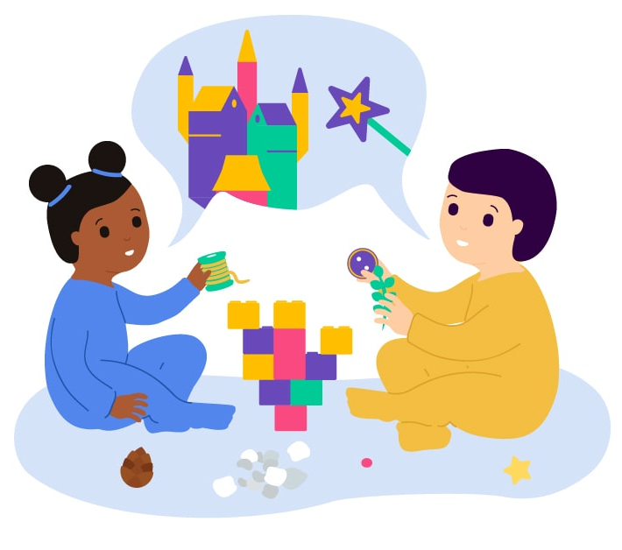
LEARNING THROUGH PLAY
Through play, children and young people of all ages develop problem-solving skills, imagination, creativity, language and observation skills, and memory and concentration. Children and young people use play to test their theories about the world and their place in it.

Slide 9
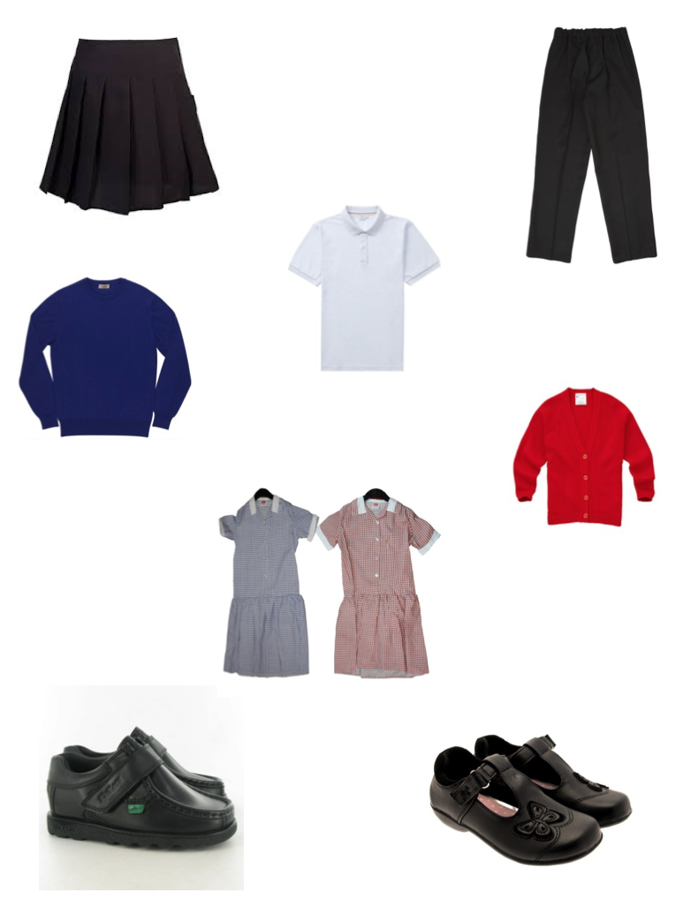
SCHOOL UNIFORM
Uniform can be bought from the school office. We feel that school uniform is important for a multitude of reasons:
It helps to develop a sense of pride and belonging.
Provides less distraction during the school day.
Makes everyone in school an equal.
Can be more cost effective than alternatives.
Above all, looks smart and ensures pupils are ready to learn.
PLEASE REMEMBER TO CLEARLY NAME ALL YOUR CHILD’S BELONGINGS!

Slide 10
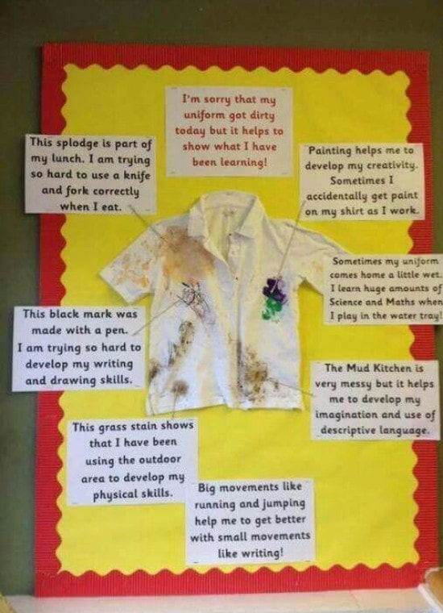
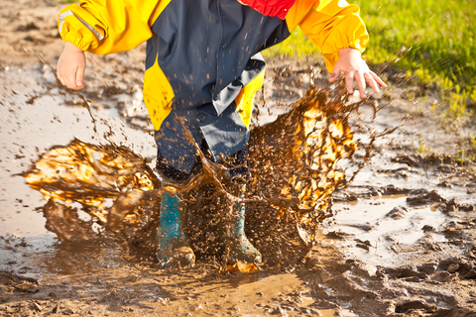
MESSY PLAY
Sometimes when we are learning we get messy. Children can bring wellies and overalls to wear but this must be in addition to their normal school uniform.

Slide 11
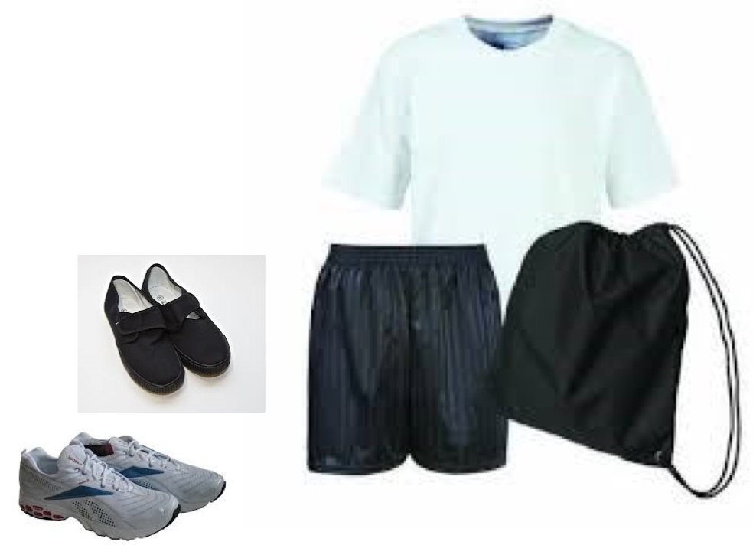
PE
Children will take part in one PE session each week. This is currently on a Tuesday.
All children come to school wearing their PE kit. All pupils require:
Plain white t-shirt
Plain black shorts
Black pumps or trainers

Slide 12

READING & PHONICS
Although your child will be taught to read at school, you can have a huge impact on their reading journey by continuing their practice at home.
There are two types of reading book that your child will bring home:
A reading practice book
A sharing book

Slide 13

SHARING BOOK
In order to encourage your child to become a lifelong reader, it is important that they learn to read for pleasure. The sharing book is a book they have chosen for you to enjoy together.
Please remember that you shouldn’t expect your child to read this alone. Read it to or with them. Discuss the pictures, enjoy the story, predict what might happen next, use different voices for the characters, explore the facts in a non-fiction book. The main thing is that you have fun!

Slide 14



READING PRACTICE BOOK
This book has been carefully matched to your child’s current reading level. If your child is reading it with little help, please don’t worry that it’s too easy – your child needs to develop fluency and confidence in reading.
Listen to them read the book. Remember to give them lots of praise – celebrate their success! If they can’t read a word, read it to them. After they have finished, talk about the book together.

Slide 15

HOME READING
Children will not take home a reading practice book with words in until after October half term.
Some children may need to stay on picture books for longer.
Books need to be brought into school everyday. Bookbags are available to buy at the office.
They will be collected in on a Thursday so that they can be changed ready for taking home on Friday.

Slide 16

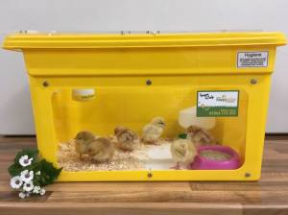

School trips and enrichment
On Wednesday 9th December, Reception children will be visiting Derby Arena to watch the Snow White pantomime. A letter with further details has already been sent home.
During the Spring Term, we will be taking the children on a local visit to the park, library and church.
In the Summer Term, we are hoping to welcome chicks into school as part of our learning. We will be fundraising for this during September and October.
We are also hoping to visit Conkers during the Summer Term. Further information will be shared closer to the time.

Slide 17

OPAL has six-monthly child developmental milestones, which we use to monitor children’s development. These milestones reflect what we believe a ‘typical’ child, should be able to achieve. We know that not all children will have ‘typical’ development. OPAL allows us to tell and celebrate each child’s story and focus on the support they need from us.
The observations and assessments that we make are called ‘spotlights’. We observe children’s innovation, their creativity, their ideas, their intents and feelings. The insight that we gain enables us to discuss, reflect and plan our environment to support and shape future learning.
OPAL follows a simple, three step cycle:
OP&L Spotlight
Meet with parents
Review and reflect

Slide 18

If you have any questions please come and find us after this meeting.
If there is any specific information about your child that you feel like you need to share we can quickly catch up tonight or arrange a separate meeting if necessary.
Transition morning is tomorrow 9:30-11:30am for all children to visit.
New children and Nursery children who attend at the end of the week to enter school at the office.
Start of the week and 30 hours children to arrive at Nursery.
Class Dojo – I will add all parents to a new class where information and photos can be shared.
Photo consent – only children with photo consent will be posted on Dojo.

